Slide 1


Types of Power BI Charts

Slide 2




Borcelle
March 24, 2036
Innovative & Collaborative
Content
Index
01
02
03
04
Company
Information
Business
Model
Company
Network
Financial
Position
05
06
07
Assets
Financial
Highlights
Stock
Highlights

Slide 3

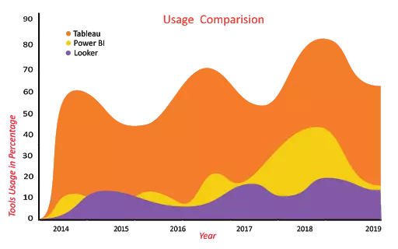

Area Charts
The below Area chart clearly shows you how the usage of Tableau, Power BI, and Looker varies over the past six years.

Slide 4

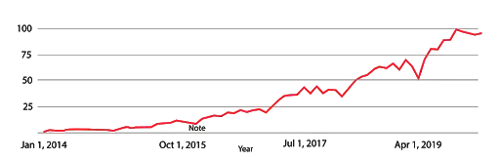
Line Charts
The below line chart shows the popularity of the Microsoft Power BI keyword in Google search across the world. It's clearly indicating that the popularity of Power BI has been increasing gradually since its inception.
Company Name:
Borcelle
Date of Incorporation:
December 23, 1990
Business:
Share Listing:
Technology services:
Internet of Things,
Artificial Intelligence,
& Blockchain.
The Company’s stock
has been listed on the
Stock Exchange since
April 24, 1995
Authorized Capital:
Paid-Up Capital:
4 Million Usd consisting
of 60,000,000,000 shares
with nominal value of 1 Usd
per share
3 Million Usd consisting
of 40,483,553,140 shares
with nominal value of 0,51
Usd per share

Slide 5

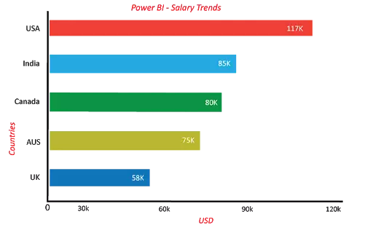


Borcelle
March 24, 2036
Innovative & Collaborative
Bar Charts
We have shown you the Power BI Developer Salary trends (Based on neuvvo.com) in different countries using the bar chart.
The above image shows the comparison of Power BI developer Salary trends in 5 different countries (UK, India, Canada, Australia,
USA). .

Slide 6
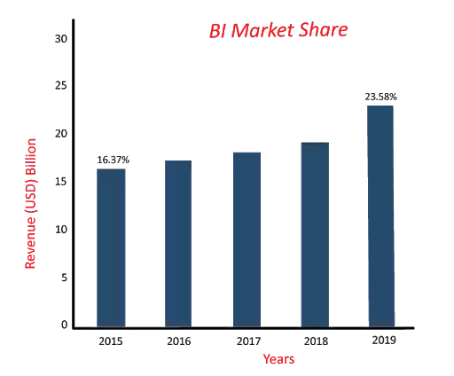

Column Charts
Let us consider one example in which we compared the BI market share with the past years.
If you have observed the below column chart, it is clear that the BI market share has been increasing gradually.
Ratio

Slide 7
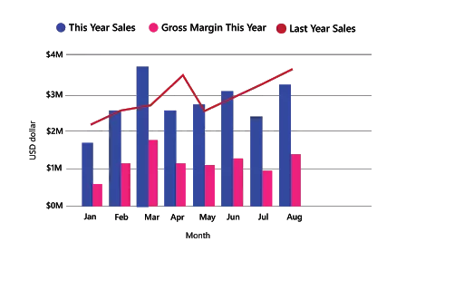

Combo Charts
In the above combo chart, you can see the comparison between last year's and current year's sales of a product and also the current year's gross margin. With the help of this combo chart, an organization can quickly analyze the data about the product to make business decisions quickly.

Slide 8
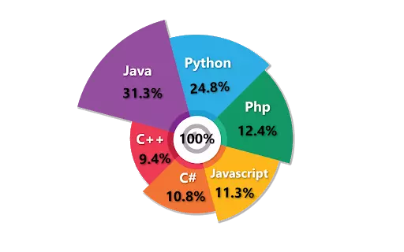

Pie Charts
In the below Pie chart, it is clear that which programming language is on the top list
in 2019.

Slide 9
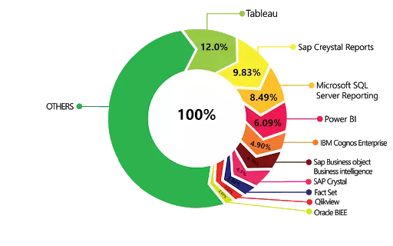
Borcelle
Doughnut Charts
Let us consider an example, top BI tools market share across the globe.

Slide 10
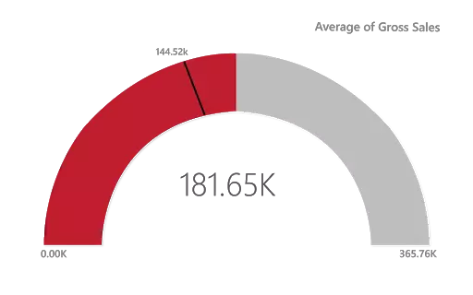
Gauge Charts
The above gauge chart shows you the average gross sales of the company.

Slide 11
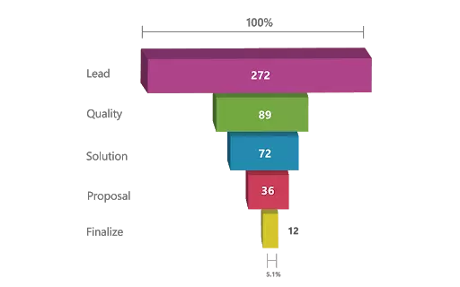

Funnel Charts
The above Funnel charts show the flow of each phase. In the below image you can see the total leads per day is 272, the quality leads are 89, solution leads are 72, proposal leads are 36, and finalize leads are 12

Slide 12

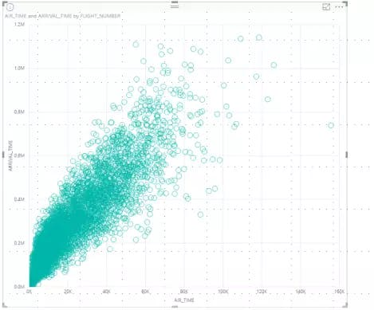
Borcelle
March 24, 2036
Innovative & Collaborative
Scatter Charts

Slide 13

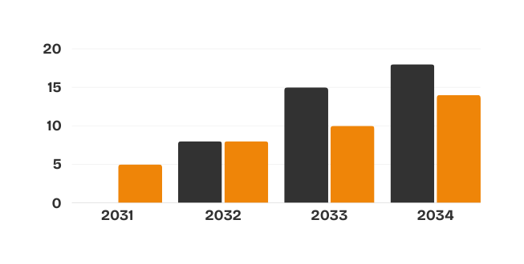


Borcelle
March 24, 2036
Innovative & Collaborative
Financial Highlights
Net Revenue
Profit Attributable

Slide 14
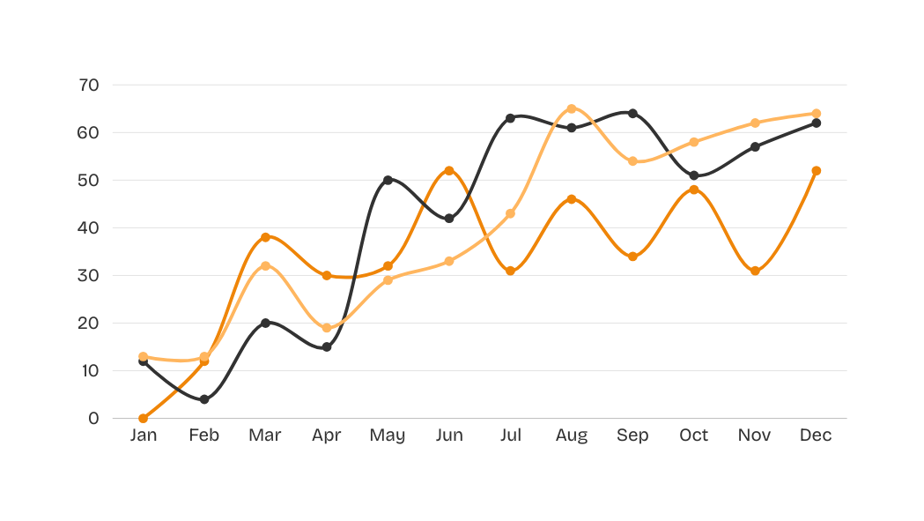

Borcelle
March 24, 2036
Innovative & Collaborative
Stock Highlights
Despite market volatility, the company outperformed important
indices due to excellent profitability, strategic acquisitions, and
positive economic indicators.
73%
68%
78%
Company Growth
Stock Growth
Financial Growth

Slide 15


Borcelle
March 24, 2036
Innovative & Collaborative
2030-2031
Lowest Price
Highest Price
Closing Price
Average Daily Trading
Volume (shares)
Period
2030
2031
2030
2031
2030
2031
2030
2031
Quarterly Company Stock Price
and Trading Volume
Quarter 1
2891
2894
3241
3198
2957
2881
19.65
19.11
Quarter 2
2.765
2414
3118
3281
2150
2413
18.10
18.40
Quarter 3
2891
2894
3241
3198
2957
2881
19.65
19.10
Quarter 4
2.765
2414
3118
3281
2150
2413
18.10
18.40
+25%
Company Value

Slide 16




Borcelle
March 24, 2036
Innovative & Collaborative
Thank
You
Write down your hopes for the future of your company.
Don't forget to thank the company for the opportunity
and convincerelated parties to support your company.
123 Anywhere St., Any City, ST 12345
www.reallygreatsite.com
+123-456-7890

